Slide 1
Covid Dashboard
Story telling

Slide 2
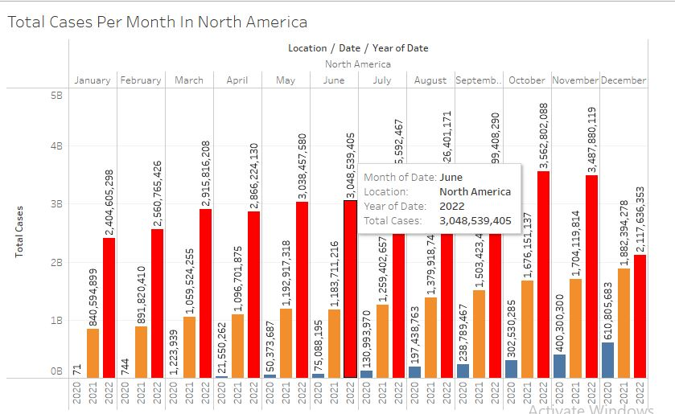
Total Cases Per Month Each Year
Number of total cases increases uptil November 2022 .

Slide 3
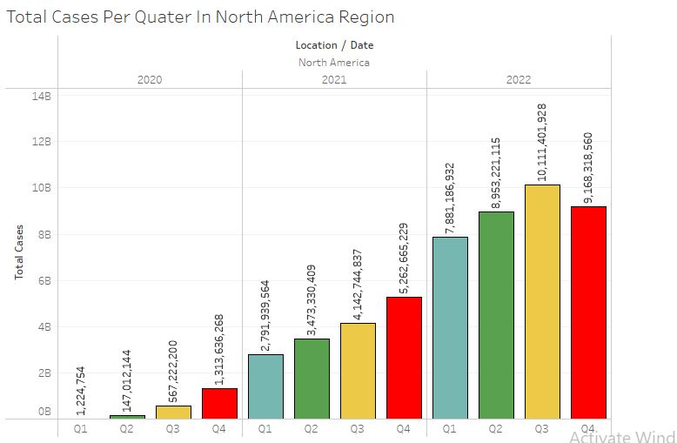
Quarterly Total cases Per Year
There is constantly increases in cases but 2020 and 2021 shows more cases in Q4 and in 2022 covid wave hit more hard in Q3.

Slide 4
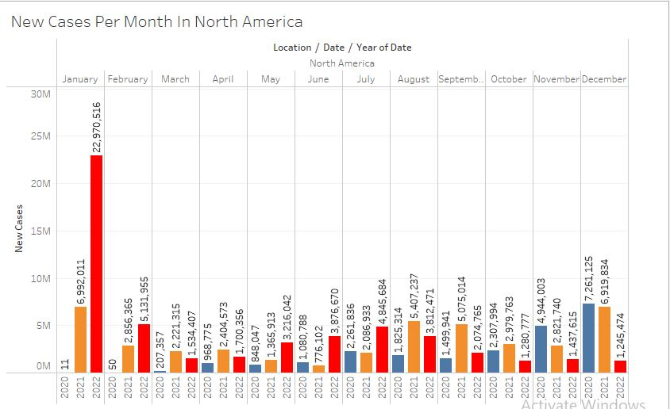
New Cases Per Month Each Year
Most new cases reported in january 2022.

Slide 5
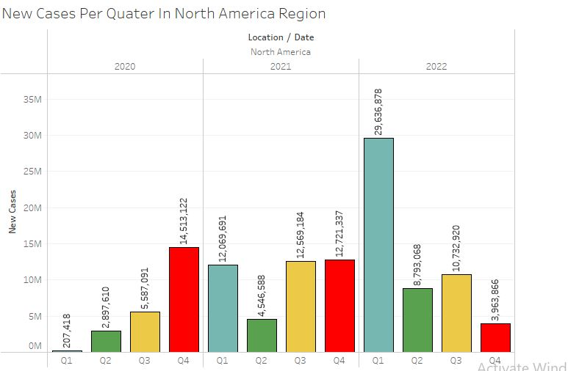
Quarterly New Cases Per Year
2020 Shows more cases in Q4 in 2021 Q1,Q3 ,Q4 are painful for public and in 2022 Q1 we have new cases reported more then other quarters .

Slide 6
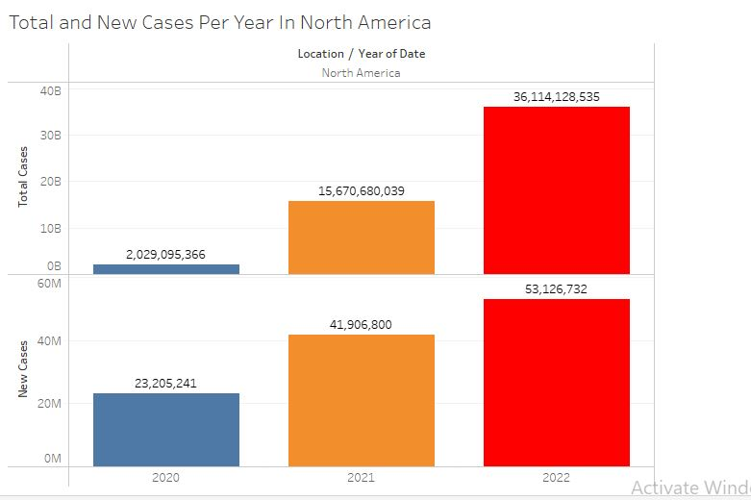
Total and New Cases and Per Year
New Cases are more Reported in 2021 , and 2020

Slide 7
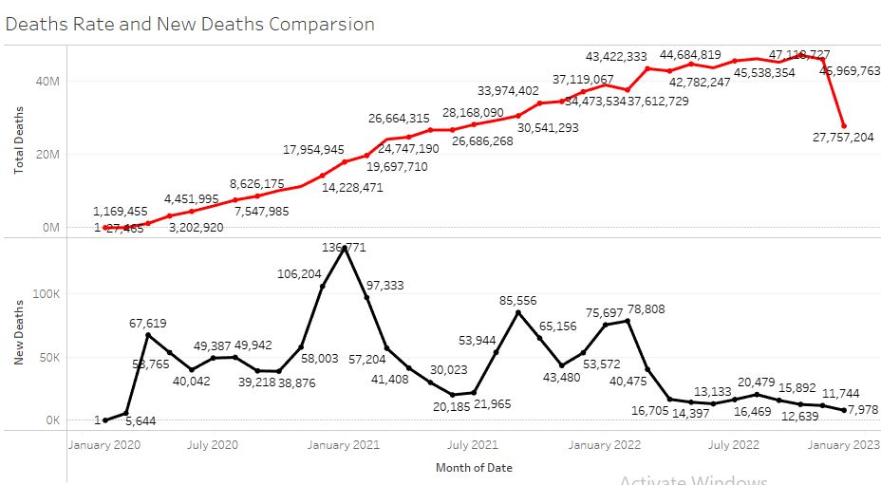
Monthly Death Rate Comparison
The Trend of Total Death Rate Continuously increases through Each Month of Every Year until Dec 2022 But New Death Rate increases More in 2021 Shapely . As we can also see total death remain increases but the new death came down It the effect of covid vaccination.

Slide 8
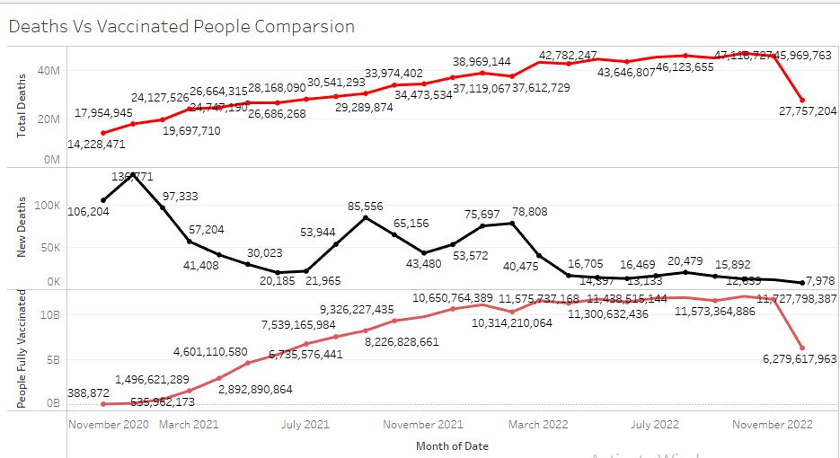
Monthly Death vs Fully Vaccinated Comparison
As we can seen that when people get full vaccinated the new death rate decreases but overall death rate increases .

Slide 9
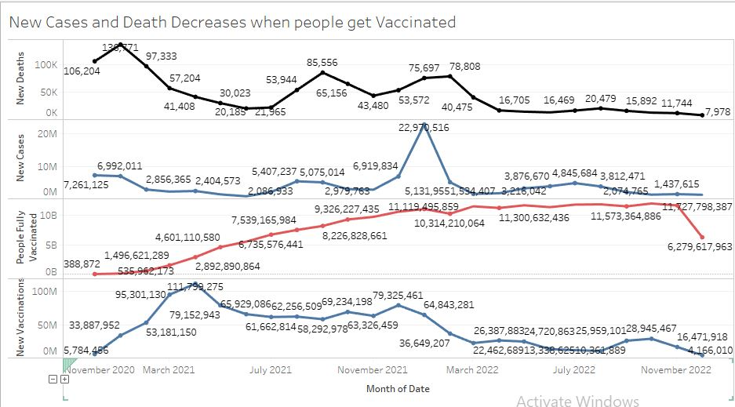
New Cases and New Death Decreases When People Get Vaccinated
As we can see after Nov 2021 the new deaths and new cases decreases when people get a fully vaccinated dose of covid .

